Slide 1
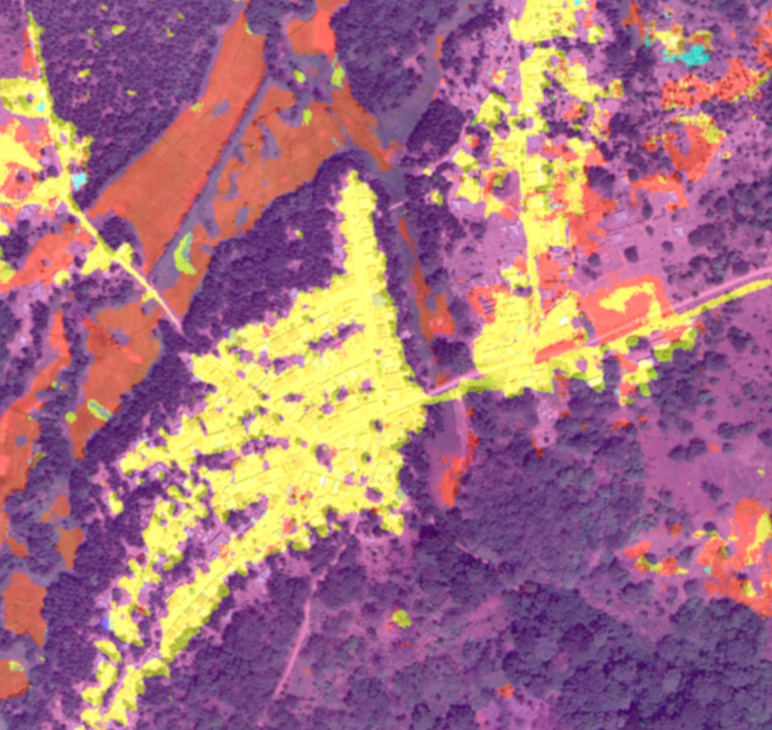
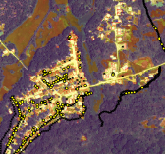
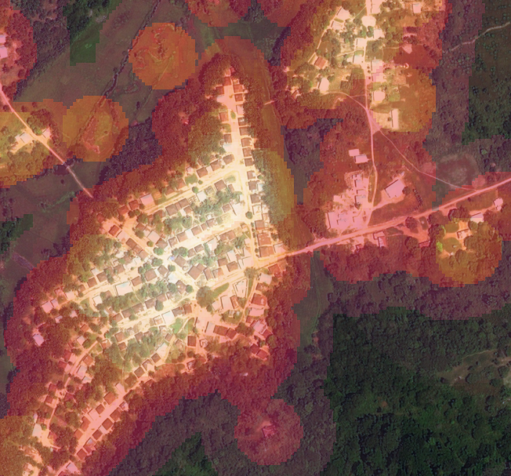
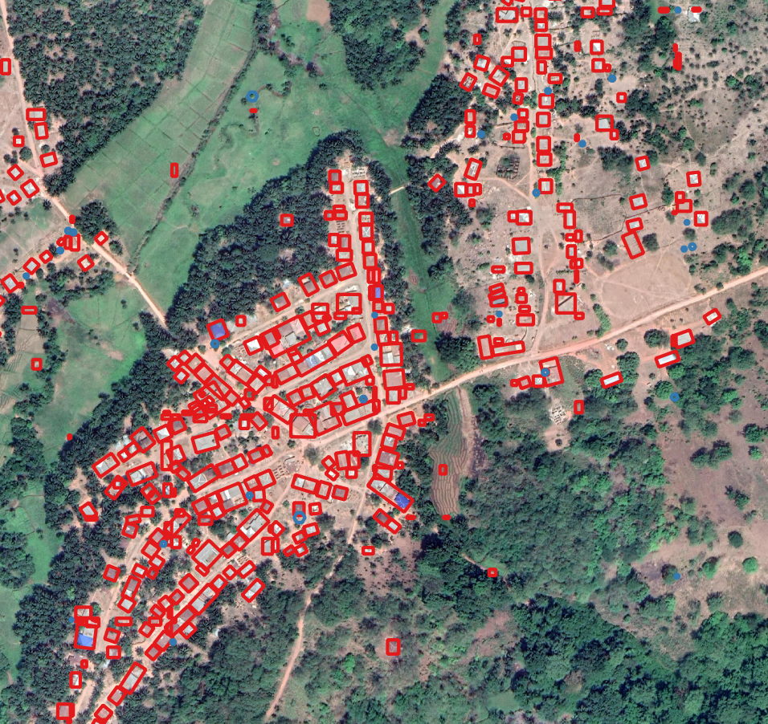

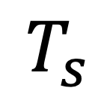
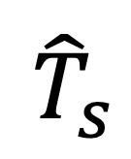
CNN model
BRT model
Environmental
$$T_{s}$$
$${\hat{T}}_{s}$$
Landcover
$$+$$
Mask R-CNN
Geotagged reservoir trapping data
Predicted trapping success
Socio-economic
Building features

